Slide 1
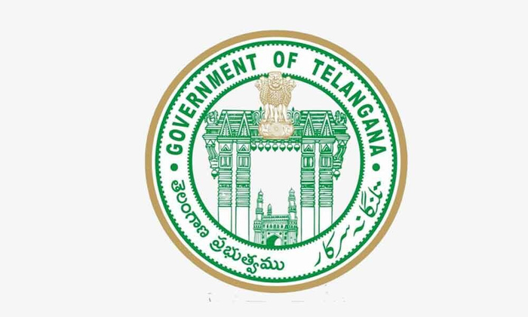

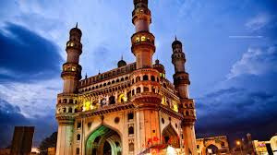
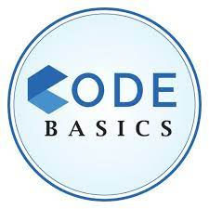
Telangana Growth Analysis
Presented by : Dikshitha Jannapala

Slide 2

About Telangana

Slide 3

Telangana is one of the youngest state in India, formed on June 2, 2014, after it was separated from the combined state of Andhra Pradesh.
Telangana prominent districts include Hyderabad, Rangareddy, Medchal-Malkajgiri, Warangal, and Karimnagar. These districts vary in terms of size, population, and economic activities.
The state's capital and largest city is Hyderabad, known for its vibrant culture, historical heritage, and as a major hub for information technology (IT) and business.
Telangana has experienced robust economic growth since its formation. The state is known for its Information Technology (IT) sector, pharmaceuticals, textiles, and agriculture. Policies like TS-iPASS have made it more attractive to businesses and investors.

Slide 4
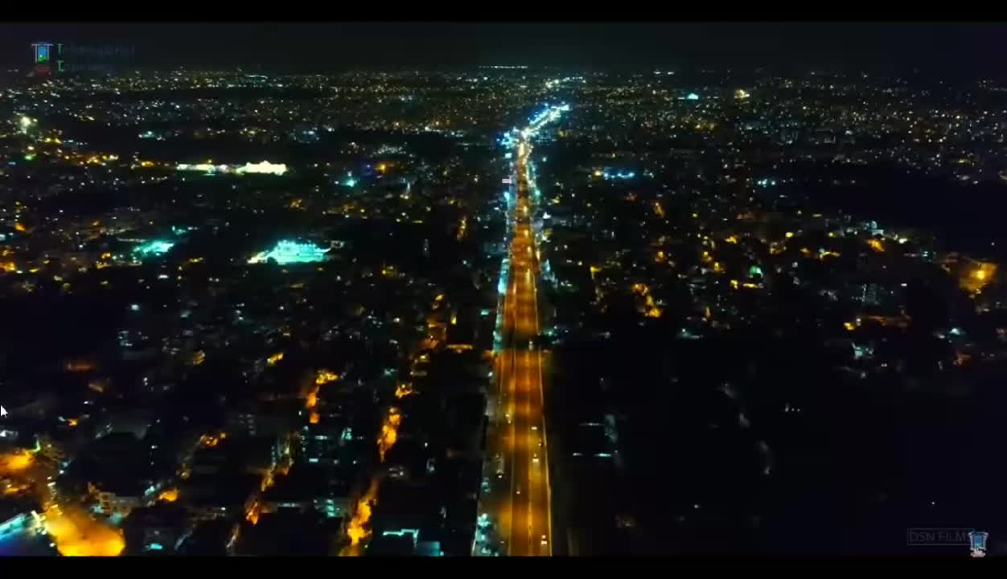

Slide 5
Content
Primary Research
Secondary Research
Stamp Registration
Transportation
TS-IPASS

Slide 6
Goals and Objectives
Objective 1
Objective 2
Objective 3
Analyze Trends and Pattern With in a Department
Identify Growth Opportunities and area needing attention
Overall Growth of the State Through Insights

Slide 7

Primary Research

Slide 8
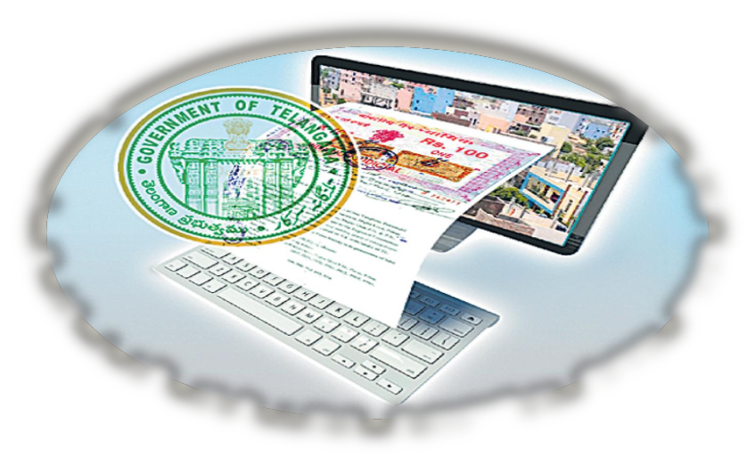
Stamp Registration
Stamp registration is a legal requirement under the Indian Stamp Act, 1899, and the Telangana Stamp Act, 1955. It ensures that certain types of documents are properly executed and registered to establish their authenticity and legal validity.
The e-stamp challan is a digital platform where individuals and entities can generate and purchase e-stamps online. This system aims to streamline the stamp duty payment process and reduce the chances of fraud.

Slide 9
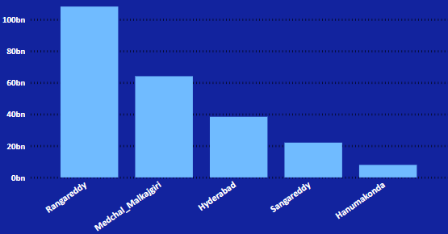
1. How does the revenue generated from document registration vary across districts in Telangana? List down the top 5 districts that showed the highest document registration revenue growth between FY 2019 and 2022.
The fact that Rangareddy is seeing the most growth in document registration revenue with 108bn, Medchal-Malkajgiri with 64bn and Hyderabad not far behind, shows that there is a lot of economic activity happening in the state. People are investing in property and other valuable things. This is a good sign because it means that the region is likely to grow and do well economically in the future.

Slide 10
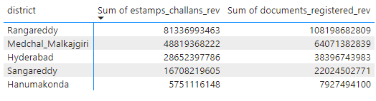
2. How does the revenue generated from document registration compare to the revenue generated from e-stamp challans across districts? List down the top 5 districts where e-stamps revenue contributes significantly more to the revenue than the documents in FY 2022?
Rangareddy
Medchal_Malkajgiri
Hyderabad
Sangareddy
Hanumakonda
0
25,000,000,000
50,000,000,000
75,000,000,000
100,000,000,000
125,000,000,000
The top 5 districts contributing to e-stamp revenue are mainly urban areas with the highest number of property registrations. This is good news for Telangana's economy. The growing use of e-stamp challans simplifies the process of paying stamp duty and registration fees, making it more convenient for people. Additionally, it plays a role in reducing corruption

Slide 11
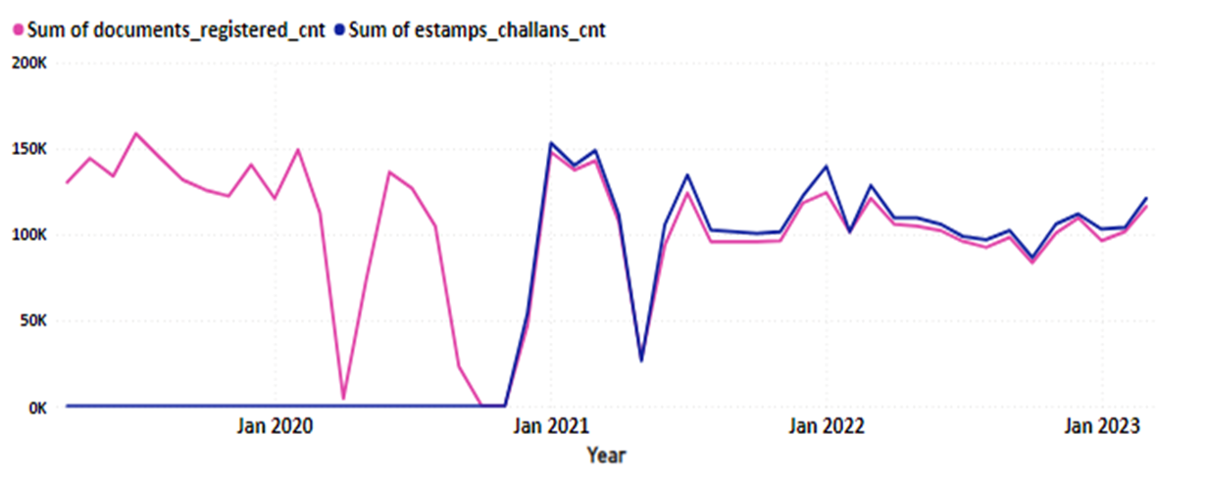
3. Is there any alteration of e-Stamp challan count and document registration count pattern since the implementation of e-Stamp challan? If so, what suggestions would you propose to the government?
The number of e-stamp challans issued has seen a substantial rise. While the number of document registrations has gone up too, it hasn't increased as dramatically as the e-stamp challans. Moreover, the average value of e-stamp challans has also gone up.

Slide 12
4. Categorize districts into three segments based on their stamp registration revenue generation during the fiscal year 2021 to 2022
Jagtial
5.8%
Nalgonda
15.1%
Nagarkurnool
9.4%
Hanumakonda
3.1%
Narayanpet
4.6%
Sangareddy
8.8%
Medak
6.1%
Vikarabad
9.4%
Bhadradri Kothagudem
5.8%
Peddapalli
6.3%
Nizamabad
15%
Rangareddy
42.8%
Nirmal
6.7%
Kamareddy
9.2%
Hyderabad
14.8%
Siddipet
9.4%
Jogulamba Gadwal
6.8%
Jangoan
7.8%
Suryapet
10.3%
Karimnagar
14.6%
Mahabubabad
7.4%
Wanaparthy
7.7%
Medchal_Malkajgiri
26%
Mahabubnagar
11.2%
Rajanna Sircilla
7.7%
High_Revenue
Medium_Revenue
Low_Revenue

Slide 13
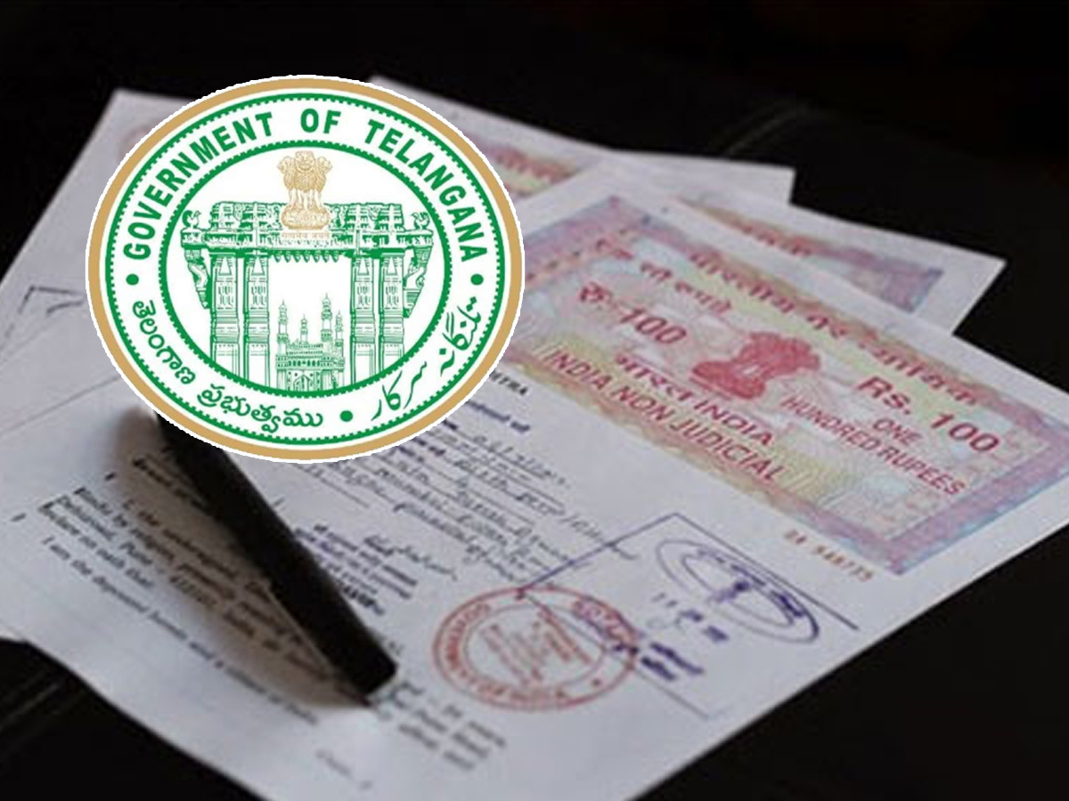
Suggestions
Online Education and Awareness Campaigns
Mobile-Friendly Platforms
Digital Payment Options
Streamlined Processes
Transparency and Accountability

Slide 14

Transportation

Slide 15
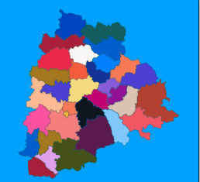
Transportation
Telangana boasts an extensive road network, with well-maintained national and state highways that connect its cities and towns. The state's strategic location in the heart of India ensures that it serves as a critical transit corridor for goods and people traveling to various parts of the country.
Telangana State Road Transport Corporation (TSRTC) operates a vast fleet of buses, connecting not only Hyderabad but also other major cities and remote areas of the state.
Telangana has an extensive railway network that connects it to major cities across India. Hyderabad serves as a significant railway hub, and several important railway lines pass through the state.

Slide 16
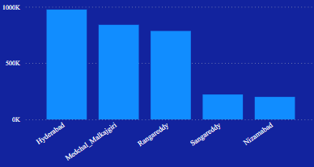
5. Investigate whether there is any correlation between vehicle sales and
specific months or seasons in different districts. Are there any months
or seasons that consistently show higher or lower sales rate, and if yes,
what could be the driving factors? (Consider Fuel-Type category only)
750 K
500 K
250 K
0 K
Jan
Feb
March
April
May
June
July
Aug
Sep
Oct
Nov
Dec
In different districts, we observe a positive relationship between vehicle sales and the months or seasons. Specifically, the months of March, June, and October consistently have higher sales rates due to factors such as financial incentives, increased demand, and favorable weather conditions. On the other hand, December, April, and July consistently show lower sales rates because of reasons like holiday season, financial constraints, and unfavorable weather.
Top 5 Districts that shows maximum sales

Slide 17
6. How does the distribution of vehicles vary by vehicle class
(MotorCycle, MotorCar, AutoRickshaw, Agriculture) across different
districts? Are there any districts with a predominant preference for a
specific vehicle class? Consider FY 2022 for analysis.
Sangareddy
6.8%
Vikarabad
16.7%
Bhadradri
18.2%
Hyderabad
25.8%
Nalgonda
27.3%
Rangareddy
33.4%
Sangareddy
15.3%
Hyderabad
50%
Khammam
18.2%
Nalgonda
8.3%
Siddipet
18.2%
Nizamabad
3.3%
Medchal_Malkajgiri
30.7%
Khammam
9.7%
Suryapet
18.2%
MotorCar
Auto_Rickshaw
Agriculture

Slide 18
Sangareddy
7.4%
Sales
AutoRickshaw
MotorCar
MotorCycle
600K
Hyderabad
34%
Rangareddy
23.8%
400K
Nizamabad
7.4%
200K
Medchal_Malkajgiri
27.4%
Motor_Cycle
0K
Hyderabad
Medchal_malkajgiri
Rangareddy
Sangareddy
Khammam
Top 5 districts with the highest number of vehicles registeration
In all four vehicle categories, Hyderabad stands out as the district with the highest number of registered vehicles. This is primarily attributed to Hyderabad's status as the most populous and economically developed district in Telangana.

Slide 19
In several districts, there has been a notable rise in motorcycle registrations. This trend can be attributed to the affordability and fuel efficiency of motorcycles, making them a preferred choice for many residents.
In urban districts, there has been a significant increase in autorickshaw registrations. This surge can be attributed to the popularity of autorickshaws as a convenient mode of transportation for short-distance travel within cities.
Among all the districts, Nalgonda and Siddipet stand out for their predominant use of agriculture vehicles. Nalgonda, in particular, leads with the highest number of registered agriculture vehicles, highlighting the district's strong agricultural focus and reliance on such vehicles for farming activities.

Slide 20
7. List down the top 3 and bottom 3 districts that have shown the highest
and lowest vehicle sales growth during FY 2022 compared to FY
2021? (Consider and compare categories: Petrol, Diesel and Electric)
FY 21
FY 22
FY 21
FY 22
300k
20k
15k
200k
10k
100k
5k
0k
0k
Hyderanad
Medchal_Malkajgiri
Rangareddy
Wanaparthy
Rajanna Sircilla
Kumurambheem
Top 3 Districts
Bottom 3 Districts

Slide 21
Hyderabad, Ranga Reddy, and Medchal-Malkajgiri consistently stand out as the top three districts in Telangana when it comes to vehicle sales. This indicates that these districts are particularly appealing for selling vehicles in the state. Several factors contribute to this attractiveness, including their substantial population size, well-developed infrastructure, and favorable economic conditions within these districts.
Wanaparthy, Rajanna Sircilla, and Kumurambheem are the three districts at the bottom of the list when it comes to vehicle sales in Telangana.
These districts may not have the necessary roads, transportation facilities, or vehicle-related services, making it less convenient for people to purchase and use vehicles.
The economic situation in these districts may not be as prosperous as in other areas, which can affect people's ability to afford vehicles.
With fewer people living in these districts, there may be fewer potential customers for vehicle dealerships, leading to lower sales figures.

Slide 22
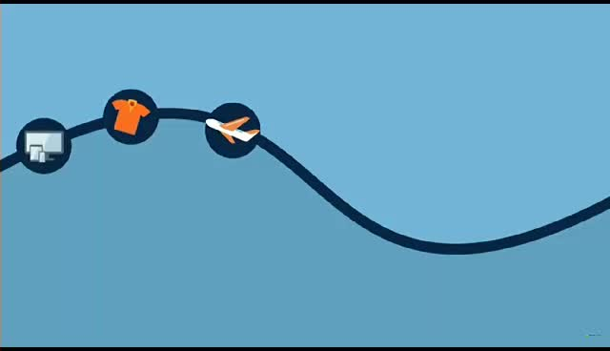
TS IPASS

Slide 23
"Telangana State Industrial Project Approval and Self-Certification System" (TS-iPASS):
One-Stop Shop: TS-iPASS is like a one-stop shop for businesses in Telangana. It makes it easier for companies to get the necessary approvals and permits to start their projects.
Faster Approvals: This system is designed to speed up the process of getting permissions. It reduces red tape and bureaucratic hurdles, which means businesses can start their projects sooner.
Online Application: Businesses can apply for approvals and certificates online through the TS-iPASS portal. This saves time and makes the process more convenient.
Self-Certification: TS-iPASS allows businesses to self-certify certain aspects of their projects. This means they can declare that they meet certain requirements without waiting for a government inspection.
Boosting Investment: By making it easier and quicker to set up businesses, TS-iPASS aims to attract more investments to Telangana. This can lead to economic growth and job opportunities in the state.

Slide 24
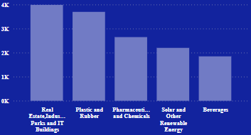
8. List down the top 5 sectors that have witnessed the most significant
investments in FY 2022.
People are investing a lot of money in building new buildings and offices. Hyderabad, one of the cities in Telangana, is quickly becoming a top place for technology companies, even competing with Bengaluru.
Telangana is trying hard to get more factories to come and set up shop in the state. They have many plastic and rubber companies already here.
Telangana is a major player in making and exporting medicines in India. Half of the medicine exports from India come from here. And one-fifth of these medicines are sent from Hyderabad, a big city in Telangana.
Telangana is really into using the sun's power to make electricity. They have rules and rewards to encourage people to put solar panels on their roofs. They're also building special parks to make more solar energy.
In Telangana, there are likely local drink brands that make special drinks for the people here. These brands are probably coming up with new and different drinks in 2022.

Slide 25
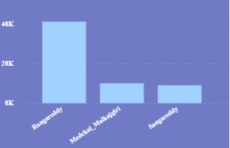
9. List down the top 3 districts that have attracted the most significant
sector investments during FY 2019 to 2022? What factors could have
led to the substantial investments in these particular districts?
Rangareddy, Sangareddy, and Medchal are the top 3 districts that attracted the most significant sector investments from 2019 to 2022:
Good Location: These districts are in a great spot. They are close to the capital city, Hyderabad, and have good transportation connections. This makes it easy for companies to set up shop and move their products around.
Infrastructure: The government has built strong infrastructure in these districts. This means they have good roads, electricity, and other facilities needed for businesses to run smoothly.
Business-Friendly Policies: The government in these districts made rules that make it easy for businesses to start and grow. They offer incentives and support to attract investments.
Skilled Workforce: There are many skilled people living in and around these districts. This means companies can find good workers to hire.
Growing Economy: The economy in these districts is getting better and better. This attracts companies looking to make money in the area. When the economy is doing well, businesses tend to invest more.

Slide 26
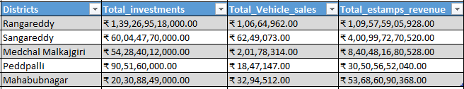
10. Is there any relationship between district investments, vehicles
sales and stamps revenue within the same district between FY 2021
and 2022?
Yes, there is correlation between district investments, vehicle sales, and stamps revenue within the same districts. When one of these factors goes up, it often has a positive effect on the others, creating a sort of chain reaction:
Investments: When more money is poured into a district through investments, it boosts the local economy. This leads to increased job opportunities and overall prosperity in the area.
Vehicle Sales: With a thriving economy and more people having stable incomes, the demand for vehicles tends to increase. People are more likely to buy cars, motorcycles, or other forms of transportation.
Stamps Revenue: As vehicle sales rise, the government collects more revenue from stamp fees during the vehicle registration process. This additional income can then be reinvested in the district for various purposes, further stimulating economic growth.

Slide 27
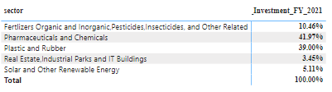
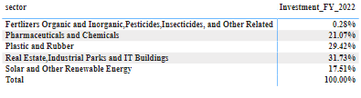
11. Are there any particular sectors that have shown substantial
investment in multiple districts between FY 2021 and 2022?
FY 2021
FY 2022

Slide 28
Sectors like plastic and rubber, real estate, pharmaceuticals, solar energy, and fertilizers to attract significant investments in multiple districts is a clear indication of their importance in driving economic growth and development in the region. Let's briefly explore why these sectors are significant:
Plastic and Rubber: These industries play a crucial role in manufacturing and packaging. They provide essential materials for various sectors, including consumer goods, automotive, construction, and more. Their versatility makes them attractive for investments, as they serve as building blocks for many other industries.
Real Estate: Real estate is often seen as a safe and profitable investment. It not only provides housing but also contributes to infrastructure development. Investments in real estate can lead to job creation, urban development, and increased property values, which boost economic growth.
Pharmaceuticals: The pharmaceutical industry is vital for public health and innovation. It attracts investments due to the constant demand for medicines and healthcare products. Research and development in pharmaceuticals can lead to breakthrough treatments and technologies, driving economic progress.
Solar Energy: As the world focuses on renewable energy sources, solar energy stands out. Investments in solar energy projects not only contribute to clean energy production but also create jobs and reduce carbon emissions, aligning with sustainability goals.
Fertilizers: Agriculture is a fundamental sector for food production. Fertilizers play a critical role in increasing crop yields. Investments in fertilizer production can enhance agricultural productivity, food security, and rural development.

Slide 29
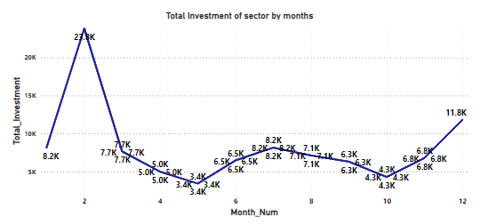
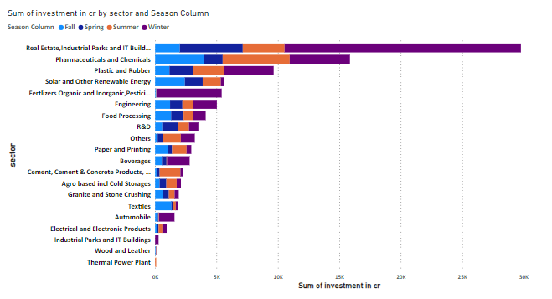
12. Can we identify any seasonal patterns or cyclicality in the
investment trends for specific sectors? Do certain sectors
experience higher investments during particular months?
Certainly! Some sectors see a pattern where more investments flow in during certain times of the year. This means that at specific months or seasons, these sectors tend to get more money from investors. It's like how some businesses do better during certain times of the year, like ice cream shops getting more customers in the summer. Similarly, some sectors get more attention from investors during certain months or seasons.

Slide 30

Secondary Research

Slide 31
What are the top 5 districts to buy commercial properties in
Telangana? Justify your answer.
The top 5 districts to buy commercial properties in Telangana are:
1.Hyderabad: Hyderabad, being the capital city of Telangana, is a prominent choice for commercial property investment. It has a robust economy with a thriving IT industry, pharmaceutical companies, and various other sectors. The city offers excellent connectivity, a skilled workforce, and a conducive business environment. Areas like HITEC City, Gachibowli, and Madhapur are known for their commercial developments.
2.Ranga Reddy: Ranga Reddy district is adjacent to Hyderabad and includes areas like Shamshabad, which is home to the Rajiv Gandhi International Airport. This district's proximity to Hyderabad and the airport makes it a favorable location for logistics, warehousing, and commercial developments.
3.Medchal Malkajgiri: Medchal Malkajgiri district, also near Hyderabad, has witnessed significant urbanization and industrial growth. Areas like Medchal and Uppal are emerging as commercial hubs. The presence of manufacturing units, warehouses, and logistics centers makes it attractive for commercial property investments.
4.Karimnagar: Karimnagar, located in the northern part of Telangana, has been experiencing economic growth, particularly in sectors like agriculture, education, and retail. While it may not be as prominent as Hyderabad, it could offer opportunities for commercial investments, especially in retail and small-scale businesses.
5.Sangareddy: Sangareddy, part of the Sangareddy-Medak region, is gaining attention due to its proximity to Hyderabad and industrial growth. The district hosts various manufacturing and industrial units. Investing in commercial properties in this region could be attractive as it benefits from Hyderabad's economic spillover.

Slide 32
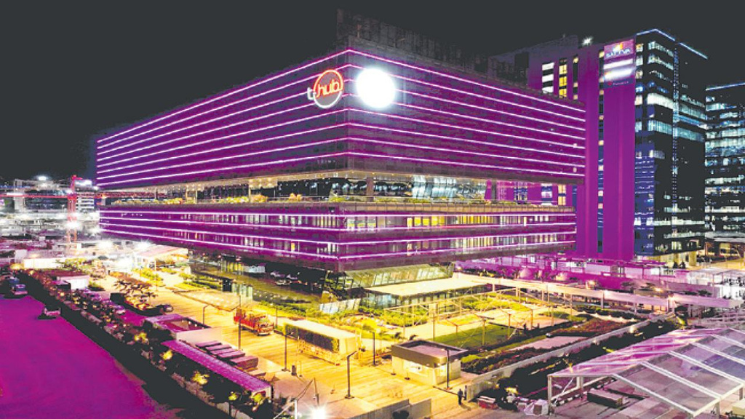
What significant policies or initiatives were put into effect to
enhance economic growth, investments, and employment in
Telangana by the current government? Can we quantify the
impact of these policies using available data?
Some significant policies and initiatives that were implemented by the government of Telangana to enhance economic growth, investments, and employment.
1.TS-iPASS: Telangana made it easier for businesses to set up and grow by simplifying the approval process. This helped attract investments and create jobs.
2.IT Hub (Cyberabad): Hyderabad became a major IT hub with government support, offering incentives to IT companies and boosting infrastructure.
3.TS-PRIDE: The government supported Dalit entrepreneurs with money and training to create jobs and economic opportunities.
4.Textile and Apparel Policy: Policies were introduced to attract investments in textiles, creating jobs in this industry.
5.TS-TETP: The government improved schools and education to create a skilled workforce for economic growth.
6.Hyderabad Pharma City: Plans were made to create a pharmaceutical hub to bring in investments and jobs in this sector.

Slide 33

Provide top 5 Insights & 5 recommendations to Telangana
government for sustained growth in the next 5 years based on
your analysis
Insights:
1.Investment-Friendly Policies: Telangana's investor-friendly policies, like TS-iPASS, have been effective. Continue to streamline regulations and provide incentives to attract more investments across sectors.
2.Technology Hub: Leveraging the IT and innovation ecosystem in Hyderabad, expand support for emerging technologies like AI, blockchain, and cybersecurity to diversify the tech sector.
3.Inclusive Entrepreneurship: The TS-PRIDE program has been successful in fostering entrepreneurship among marginalized communities. Expand and strengthen similar programs to promote economic inclusion.
4.Manufacturing and Textiles: The focus on textiles and manufacturing has potential. Encourage more investments in these sectors and promote exports to generate employment and economic growth.
5.Skills Development: Continue investing in education and skill development, especially in digital skills, to create a skilled workforce that can support diverse industries.

Slide 34

Recommendations:
1.Infrastructure Development: Invest in infrastructure, including transportation and logistics, to facilitate easier movement of goods and people, which is vital for economic growth.
2.Green Energy: Promote renewable energy projects like solar and wind farms to ensure sustainable development and reduce environmental impact.
3.Rural Development: Pay attention to rural areas by enhancing agricultural practices, promoting agribusiness, and improving rural infrastructure to reduce urban-rural economic disparities.
4.Innovation Ecosystem: Strengthen partnerships between government, academia, and industry to foster innovation and research, which can drive economic growth through new technologies and startups.
5.Export Promotion: Develop strategies to boost exports by supporting local businesses in reaching international markets, thereby increasing foreign exchange and economic stability.

Slide 35
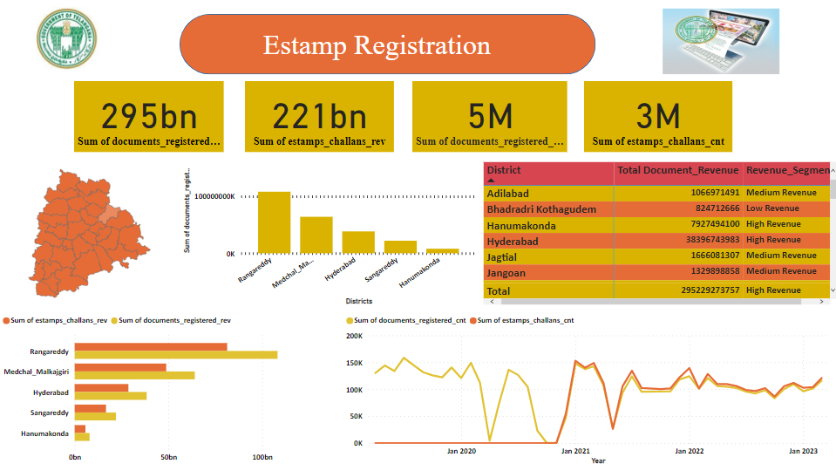

Slide 36
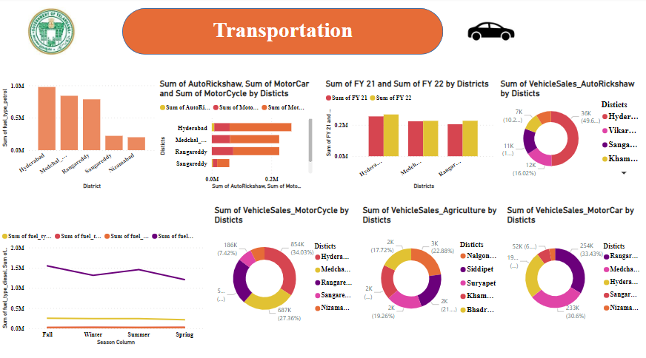

Slide 37
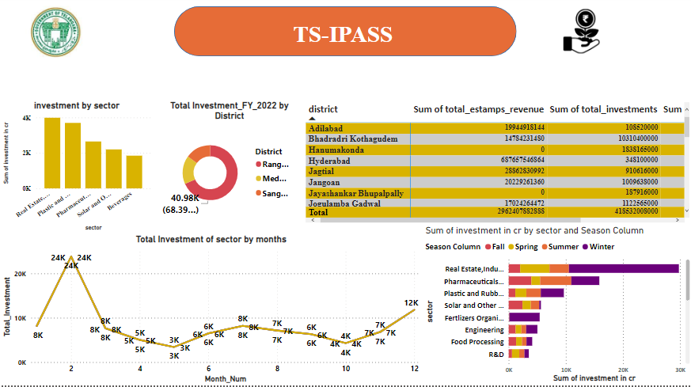

Slide 38

THANK YOU!!!

